Slide 1
AIR STANDARD CYCLES
Department of Mechanical Engineering
Pulchowk Campus, IOE
2016

Slide 2
ASSUMPTIONS IN AIR STANDARD CYCLES
The gas in the engine cylinder is air (a perfect gas), i.e., it obeys the gas laws and has constant specific heat.
The physical constants of the gas in the engine cylinder are same as those of air at moderate temperatures.
All the compression and expansion processes are adiabatic and they take place without any internal friction.
Heat is supplied by bringing a hot body in contact with the cylinder at appropriate points during the process. Similarly, heat is rejected by bringing a cold body in contact with the cylinder at these points.
The cycle is considered to be closed one and the same air is used again and again to repeat the cycle.
No chemical reaction takes place in the engine cylinder.

Slide 3
OTTO CYCLE

Slide 4
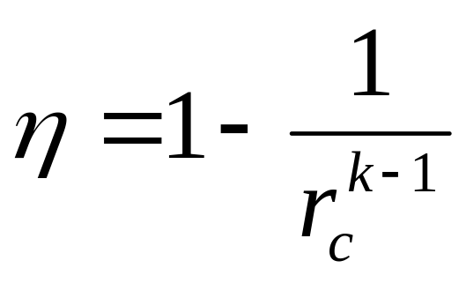
Thermal Efficiency of Internal Combustion Engine
Thermal efficiency for Otto cycle: Where, compression ratio, r_{c} = v₁/v₂ and k = c_{p}/c_{v} η_{OTTO} increases with the increase of r_{c} & k

Slide 5
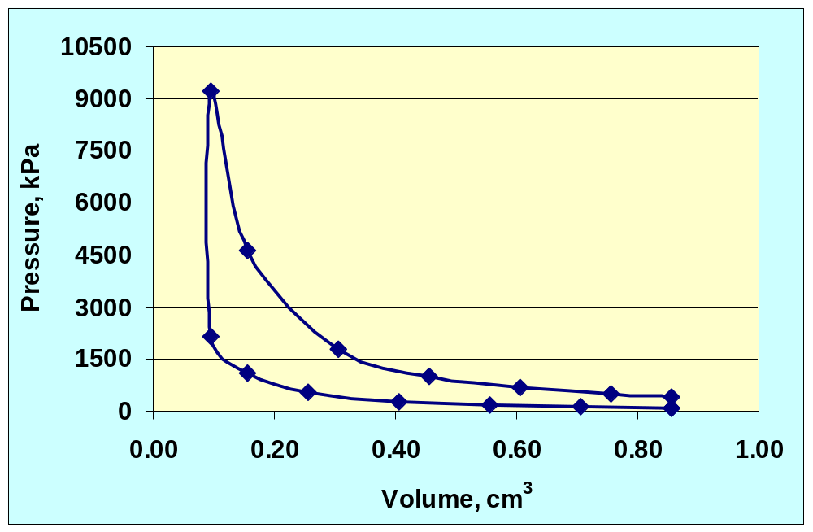
OTTO CYCLE FOR SI ENGINE

Slide 6
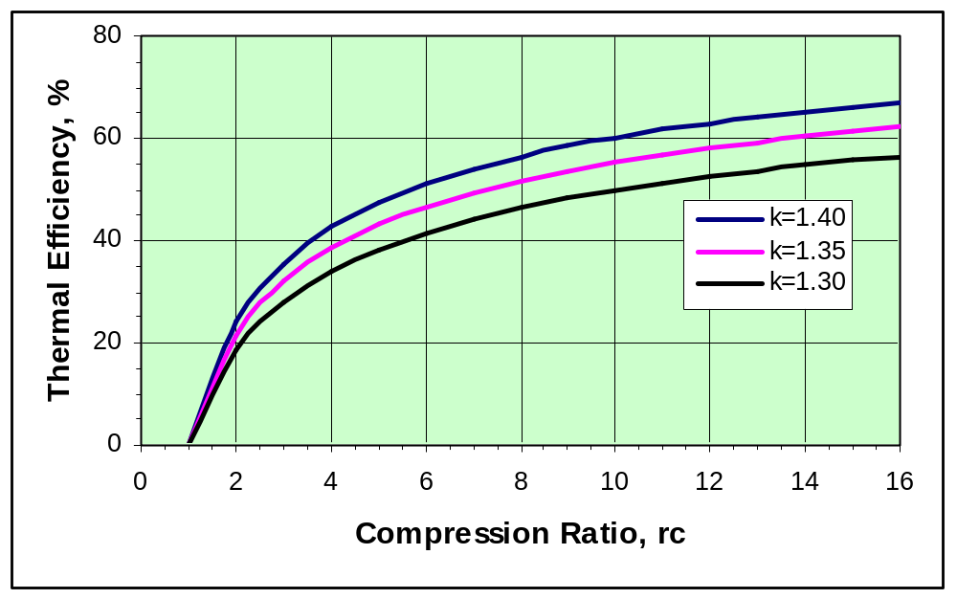
Thermal Efficiency of Otto Cycle

Slide 7
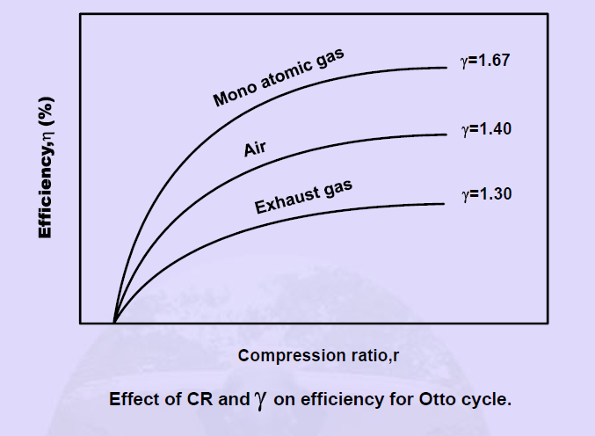
VARIATION OF THERMAL EFFICIENCY WITH COMPRESSION RATIO

Slide 8
DIESEL CYCLE

Slide 9
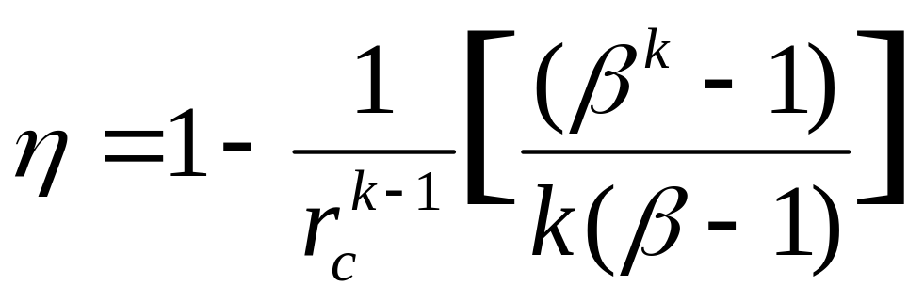
Thermal Efficiency of Internal Combustion Engine
Thermal efficiency for Diesel cycle: Where, Compression ratio, r_{c} = v₁/v₂ and k = c_{p}/c_{v} Cut off ratio, β = v₃/v₂ = T₃/T₂ The term in the bracket is always > 1. So the η_{DIESEL} < η_{OTTO} for the same r_{c}

Slide 10
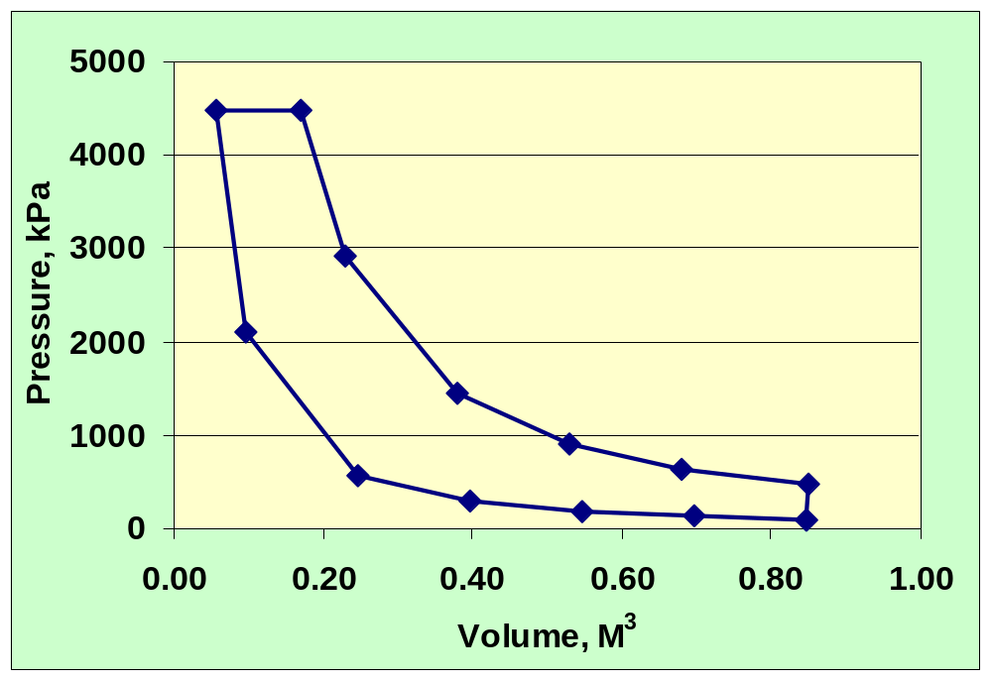
DIESEL CYCLE FOR CI ENGINE

Slide 11
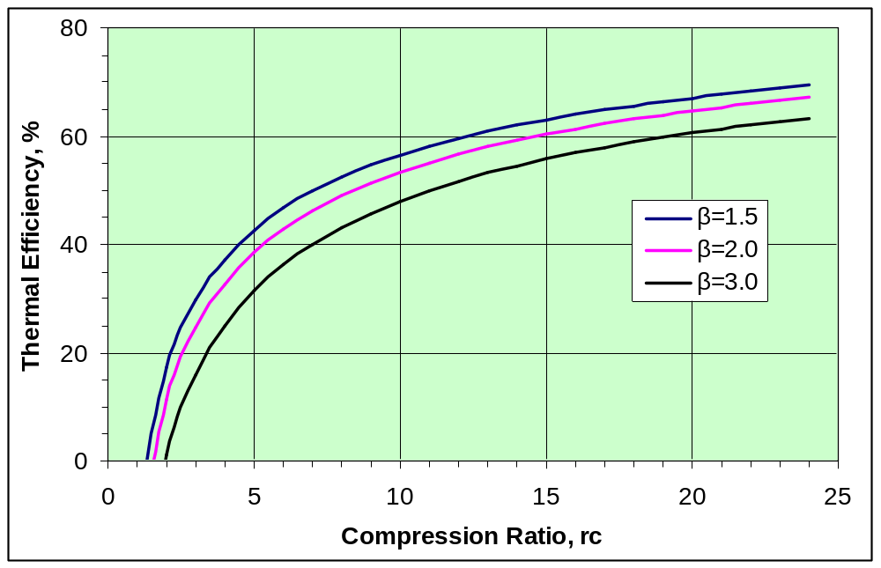
Thermal Efficiency of Diesel Cycle

Slide 12
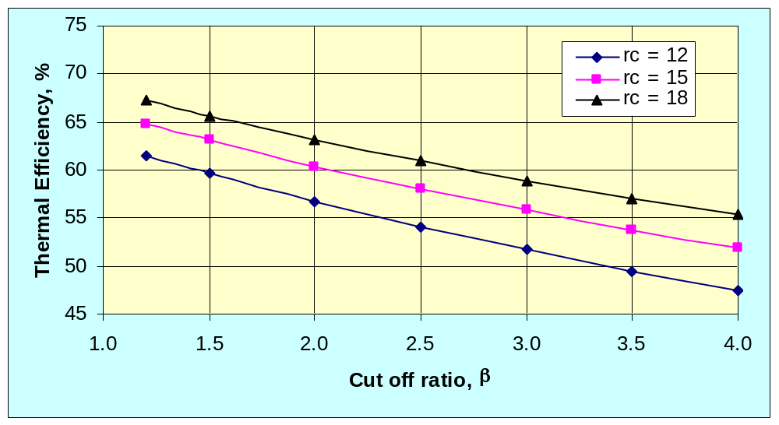
THERMAL EFFICIENCY VS CUT OFF RATIO FOR DIESEL CYCLE

Slide 13
DIESEL CYCLE
Advantages:
Very mature and widespread technology, relatively low cost and high reliability, high efficiency (fuel economy of 200-250 g/kWh for modern engines), long life, relatively low thermal signature. Power density of the prime mover (only) is 100 to 400 W/kg over the 1-40 kW power output range. Initial cost is about $100 to 250 per kW, and operating costs are low. Can meet EPA emission standards.
Disadvantages:
Can produce high noise and vibration, which increases with rotational speed.

Slide 14
DUAL OR LIMITED PRESSURE CYCLE

Slide 15
INTRODUCTION TO DUAL CYCLE
Diesel cycle would operate on the more efficient higher compression ratios, while constant volume combustion of the Otto cycle would give higher efficiency for a given compression ratio.
The modern CI engine operates to meet this by injecting the fuel much earlier in the cycle, somewhere around 20º bTDC. The first fuel then ignites late in the compression stroke, and some of the combustion occurs almost at constant volume at TDC, much like the Otto cycle.
The last of the fuel is still being injected at TDC, and combustion of this fuel keeps the pressure high into the expansion stroke.

Slide 16
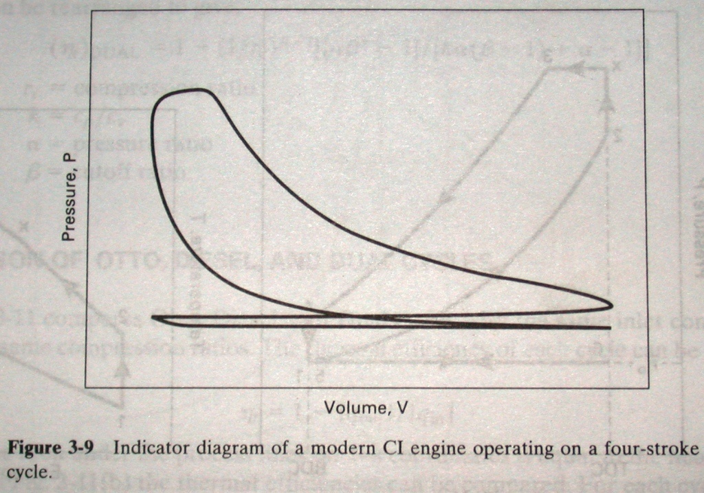
ACTUAL CYCLE IN CI ENGINE

Slide 17
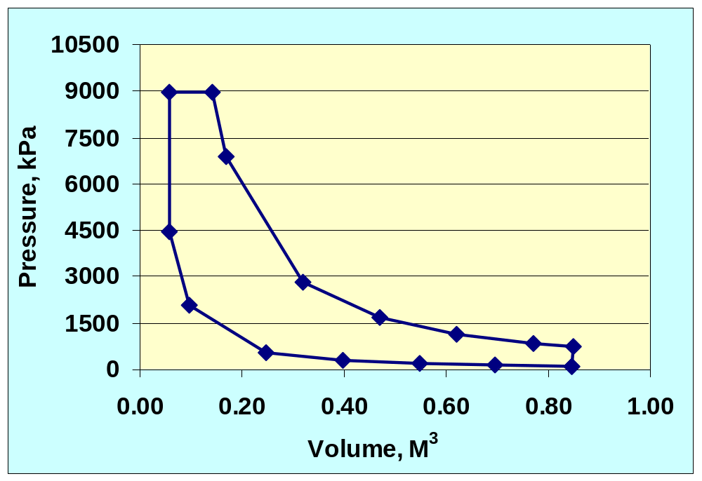
DUAL CYCLE

Slide 18
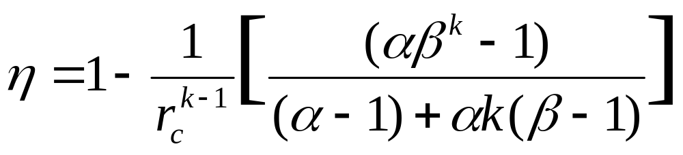
Thermal Efficiency of Internal Combustion Engine
Thermal efficiency for Dual cycle: Where, r_{c} = v₁/v₂ and k = c_{p}/c_{v} β = v₃/v₂ = T₃/T₂ and pressure ratio,α = P₃/P₂ Since α > 1, the η_{DUAL} is < η_{DIESEL} for the same β and r_{c} α = 1 for Diesel Cycle and β = 1 for Otto cycle

Slide 19
DUAL/LIMITED PRESSURE CYCLE
The theoretical cycle of modern high speed diesel engine is more adequately by dual combustion or limited pressure cycle.
In this cycle part of the heat addition takes place at constant volume and the remainder at constant pressure.
Heat addition at constant volume tends to increase the efficiency of the cycle whereas switching over to constant pressure heat addition limits the maximum cylinder pressure.

Slide 20
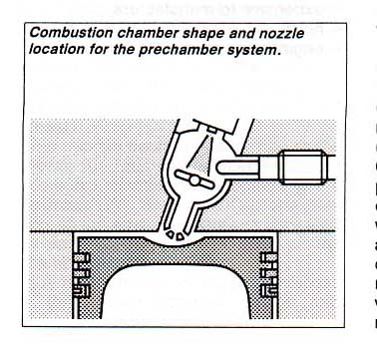
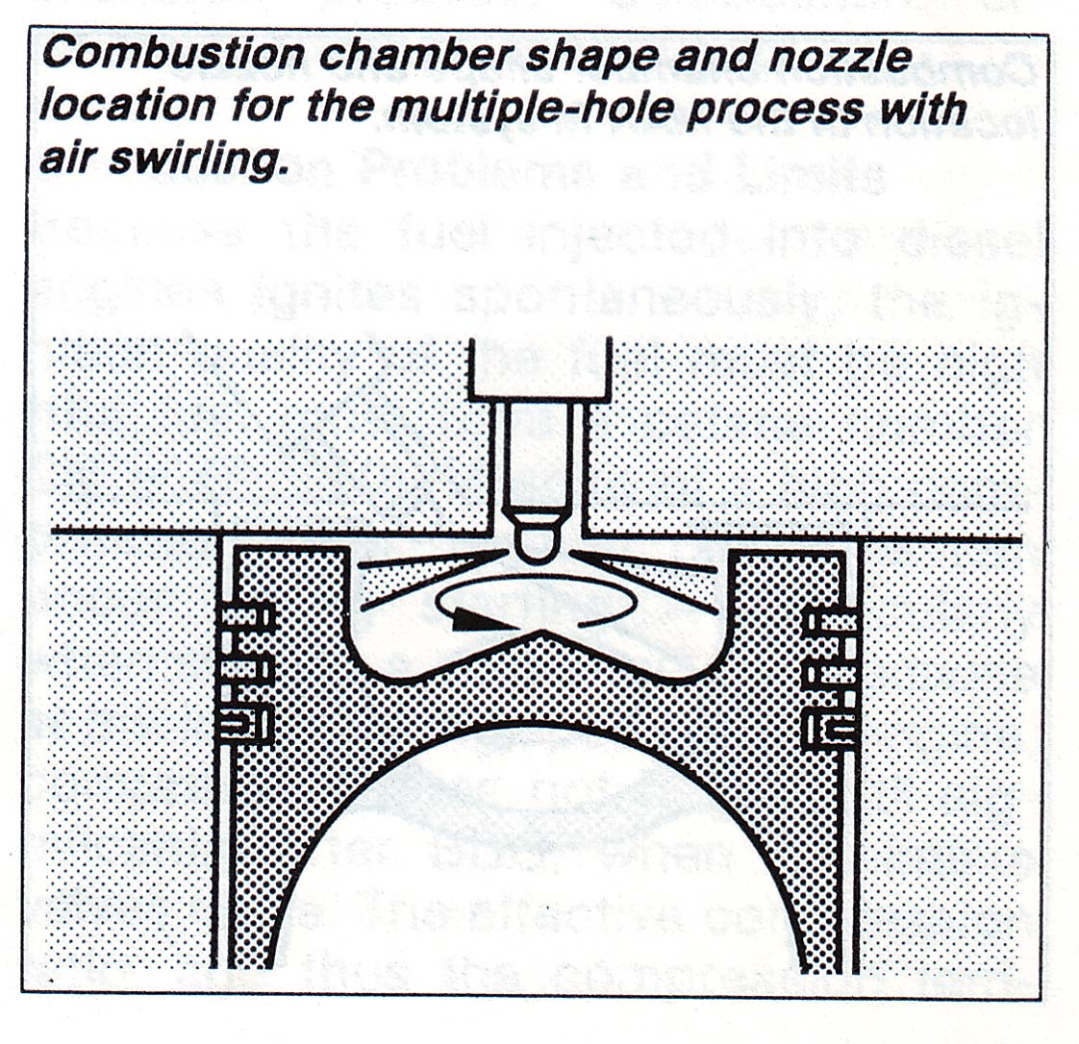
COMBUSTION CHAMBER FOR DIESEL ENGINE

Slide 21
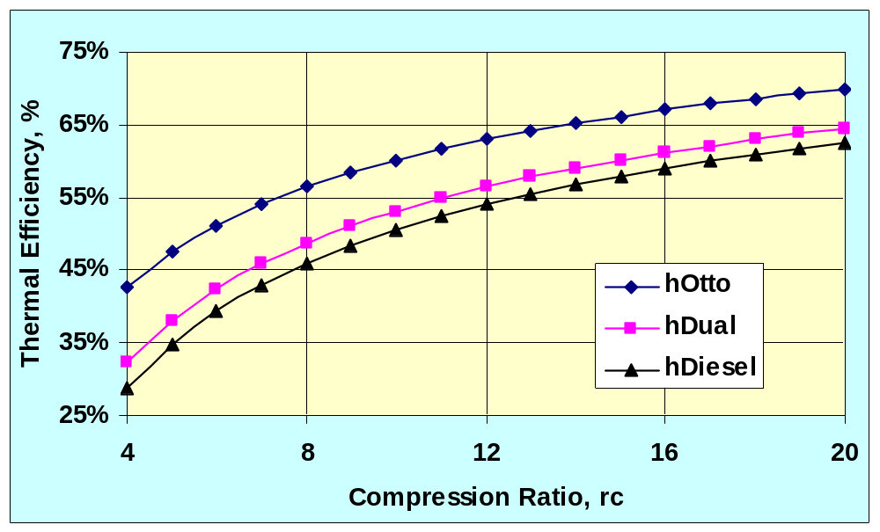
THERMAL EFFICIENCY VS COMPRESSION RATIO FOR DIFFERENT CYCLES

Slide 22
COMPARISON OF CYCLES
For the same compression ratio and same heat input
  η_{OTTO} > η_{DUAL} > η_{DIESEL}
For the peak pressure and same heat input
  η_{OTTO} < η_{DUAL} < η_{DIESEL}
For the peak pressure and maximum temperature
  η_{OTTO} < η_{DUAL} < η_{DIESEL}

Slide 23
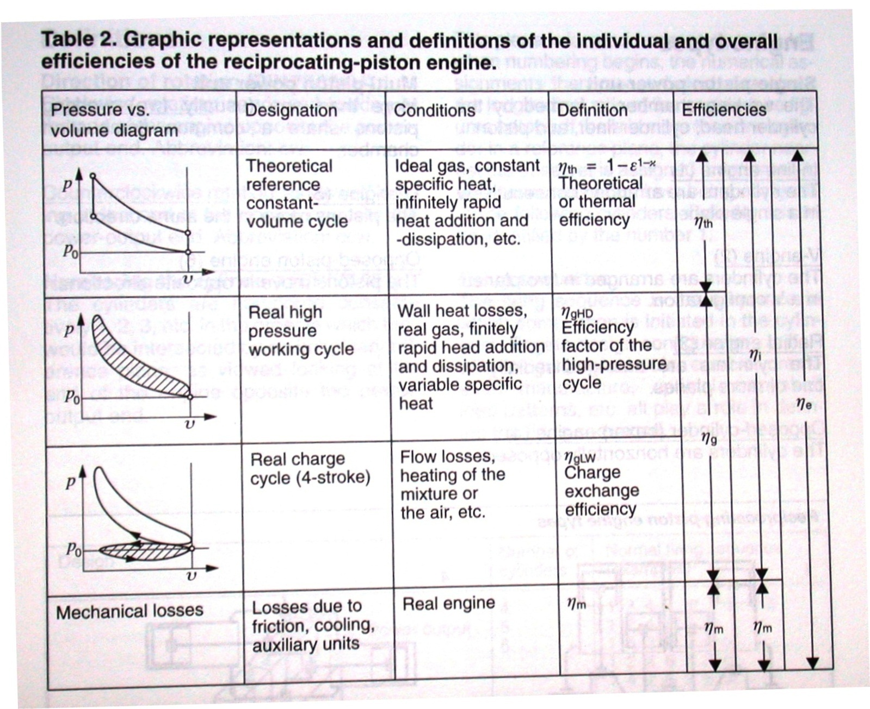
OVERALL EFFICIENCY OF SI ENGINE

Slide 24
DEFINITION OF EFFICIENCIES
η_{e} – overall efficiency includes the sum of all losses, and can thus be defined as the ratio of effective mechanical work to the mechanical work equivalent of the supplied fuel.
η_{i} – indicated efficiency is the ratio of indicated high-pressure work to the calorific content of the supplied fuel.
η_{g} – efficiency of cycle factor includes all internal losses occurring in both high-pressure and low-pressure processes.
η_{m} – mechanical efficiency defines the relationship between the effective work available at the crankshaft and the indicated work.
η_{th} – thermal efficiency is the efficiency of the ideal constant volume combustion cycle.

Slide 25
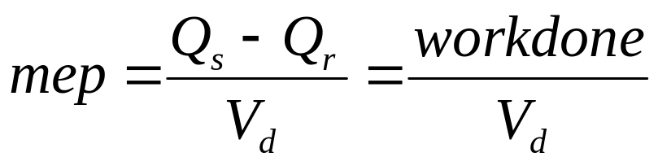
Mean effective pressure =
  = work done during the cycle / Stroke volume
  Where,
  Q_{s} – energy supplied by burning of fuel
  Q_{r} – heat loss through exhaust

Slide 26
TYPICAL VALUES FOR BMEP
Naturally aspirated spark-ignition engines, bmep = 850 – 1050 kPa at the engine speed where max. torque is obtained and at the rated power, bmep values are 10 to 15 percent lower.
Turbocharged automotive SI engines the max bmep = 1250 – 1700 kPa and at max. rated power bmep is 900 – 1400 kPa.
Naturally aspirated 4-stroke diesels the max bmep = 700 – 900 kPa and at the max. rated power = 700 kPa.
Turbocharged 4-stroke diesel, the max bmep = 1000 – 1200 kPa and at max. rated power bmep is 850 – 950 kPa.

Slide 27
ACTUAL CYCLES
Actual cycles differ from ideal cycles because of
the following factors:
Variation of air-fuel ratio
Valve operation and timing
Finite combustion time
The actual combustion process
Dissociation
Exhaust blowdown
Heat transfer
Fluid friction

Slide 28
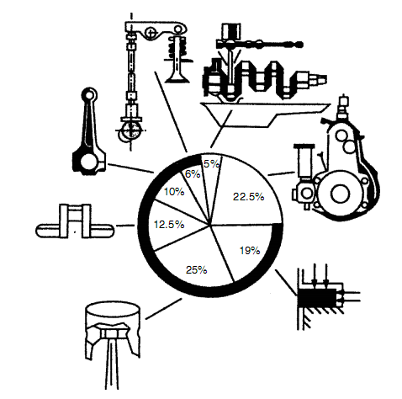
Distribution of friction losses in an internal combustion engine

Slide 29
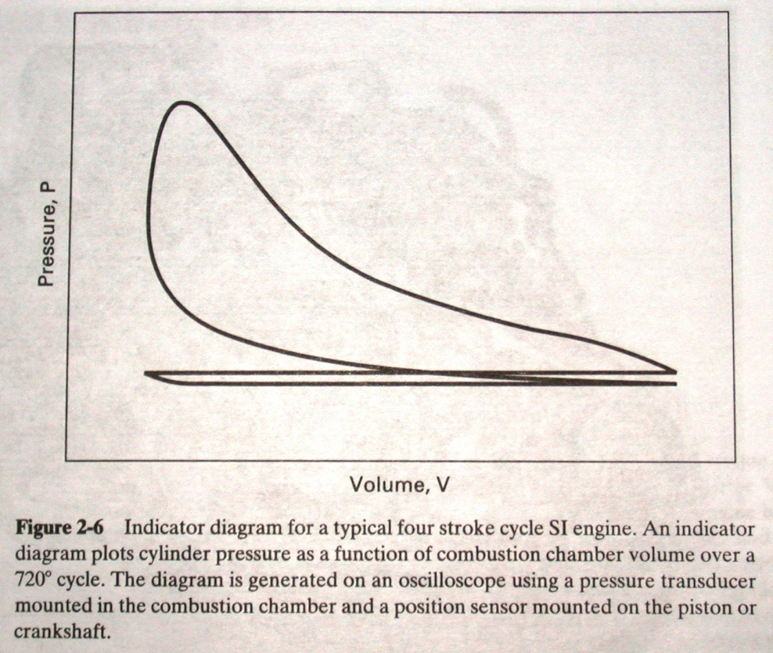
ACTUAL CYCLE IN SI ENGINE

Slide 30
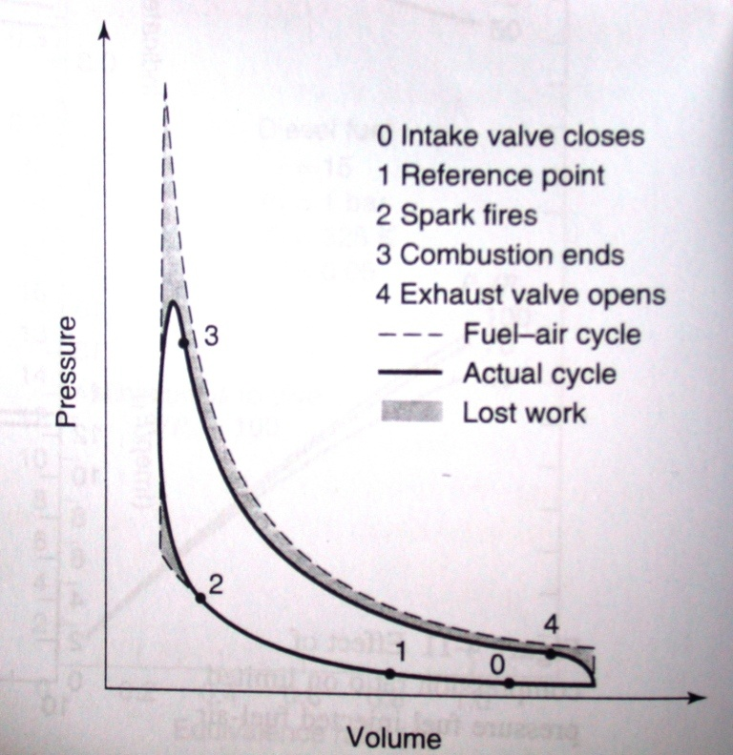
LOST WORK
Heat loss
Mass loss
Finite burn rate
Finite blowdown rate
These losses result in the actual efficiency being less than that of equivalent fuel-air cycle by a factor ranging from 0.8 to 0.9 (η/η_{Otto}).
The imep is maximized slightly rich of stoichiometric, and increases with increasing compression ratio and inlet pressure.

Slide 31
ACTUAL CYCLE IN CI ENGINE

Slide 32
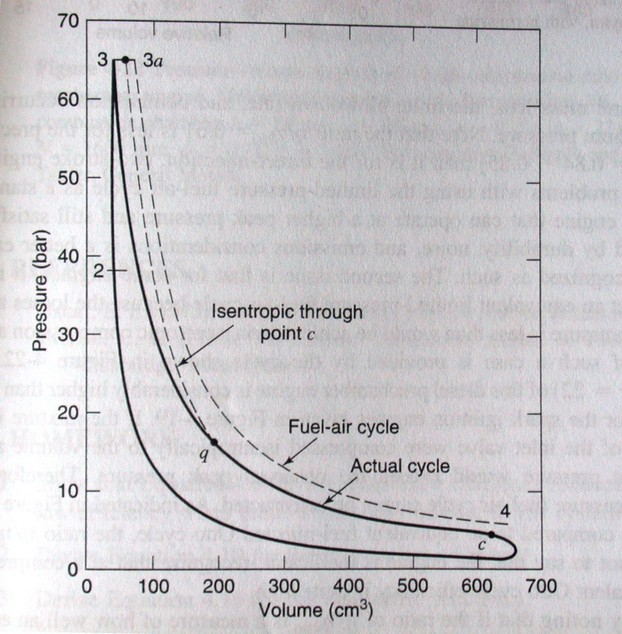
LOST WORK
Heat loss
Mass loss
Finite blowdown rate
Combustion occurring at less than the maximum pressure
The figure shows the cylinder pressures in a diesel pre-chamber engine compared with equivalent limited pressure fuel-air cycle.

Slide 33
MAIN DIFFERENCE BETWEEN ACTUAL AND THEORETICAL CYCLES
Compression and expansion are not friction less adiabatic processes. A certain amount of friction is always present and there is considerable heat transfer between the gases and cylinder wall.
Combustion does not occur either at constant volume or at constant pressure.
The thermodynamics properties of the gases after combustion are different than those of the fuel-air mixture before combustion.
The combustion may be incomplete.
The specific heats of the working fluid are not constant but increases with temperature.

Slide 34
MAIN DIFFERENCE BETWEEN ACTUAL AND THEORETICAL CYCLES
The cylinder pressure during exhaust process is higher than the atmosphere. As a result, more work has to be done by the piston on the gases to expel them out of the cylinder, than work done by the gases on the piston during the intake stroke.
This difference in work, called pumping work, is represented by the pumping loop shown by hatched are.
Note that this work is negative and represents loss of work called pumping loss.

Slide 35
CONCLUSIONS
The thermal efficiency of actual Otto cycle in SI engine is about 25-30%.
Similarly the thermal efficiency of actual Diesel cycle in CI engine is 30-35%
Desirable increase in thermal efficiency of IC engine very much depends on material, air-fuel ratio, ignition timing, fuel injection timing, residual gases in the cylinder etc.

Slide 36
REVIEW PROPBLEMS
An air standard Otto cycle has a compression ratio of 8 and temperature and pressure at the beginning of compression are 20°C and 1 bar respectively. The constant volume heat addition is 1800 kJ/kg. Calculate the maximum temperature and pressure for the cycle and the temperature at the end of the expansion process. What is the efficiency and mean effective pressure of the cycle. Take c_{v}=0.718 kJ/kg.K and k=1.4
The initial condition of air in an Otto cycle is 288K and 1.05 bar. The air compressed isentropically to a pressure 13 bar. Then heat is added at constant volume till the pressure becomes 35 bar. Calculate:
  Compression ratio
  Air standard efficiency
  Mean effective pressure of the cycle

Slide 37
REVIEW PROPBLEMS
In an air-standard Diesel cycle, the compression ratio is 16, the cylinder bore is 200 mm and the stroke is 300 mm. Compression begins at 1 bar and 27°C. The cut-off takes place at 8 percent of the stroke. Determine:
  The pressure, the volume and the temperature at all salient points [V₁=0.010048m³, V₂=0.000628m³, m=0.01167 kg, p₂= 48.5 bar, T₂= 909.4K]
  The cut-off ratio [2.2]
  The air standard efficiency [60.4%]
  The mean effective pressure [8.21 bar]

Slide 38
Review question on diesel cycle
Given:
  Cylinder bore = 200 mm and stroke = 250 mm
  Rc = 18 and β = 2
  P1 = 0.1 MPa and T1 = 300K
Find:
  T and P in state 2,3 & 4
  Thermal efficiency (η), work done and mep

Slide 39
REVIEW PROPBLEMS
An air-standard Dual cycle has a compression ratio of 15, and the compression begins at 1 bar, 27°C. The maximum pressure is limited to 60 bar. The heat transferred to air at constant volume is twice that at constant pressure. Calculate:
  a) the pressures and temperatures at the cardinal points of the cycle, [T₂=886K, p₂=44.3 bar, T₃=1200K, T₄=1312K, β=1.093, T₅=460K, W=223 kJ/kg
  b) the cycle efficiency, [66%] and
  c) the mean effective pressure of the cycle. [2.77 bar]

Slide 40
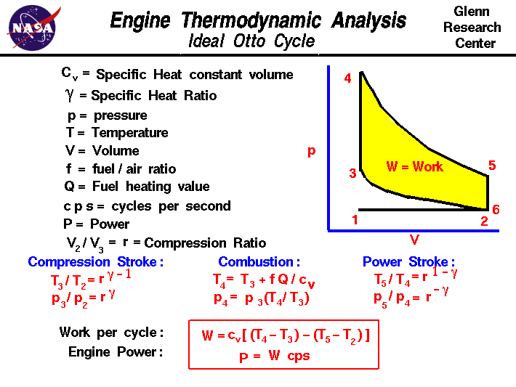
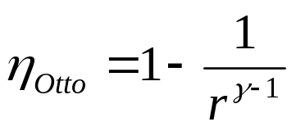

Slide 41
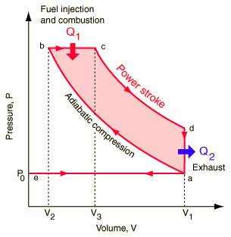
Diesel cycle
http://hyperphysics.phy-astr.gsu.edu/hbase/thermo/diesel.html

Slide 42
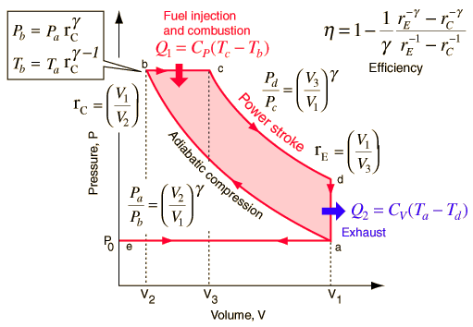
DIESEL ENGINE CYCLE
http://hyperphysics.phy-astr.gsu.edu/hbase/thermo/diesel.html

Slide 43
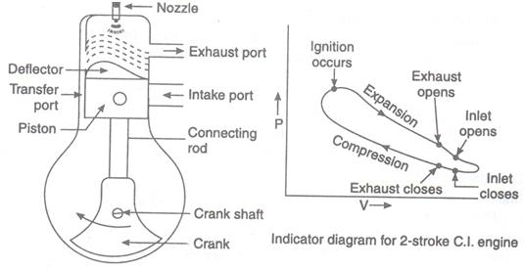
2 stroke working cycle

Slide 44
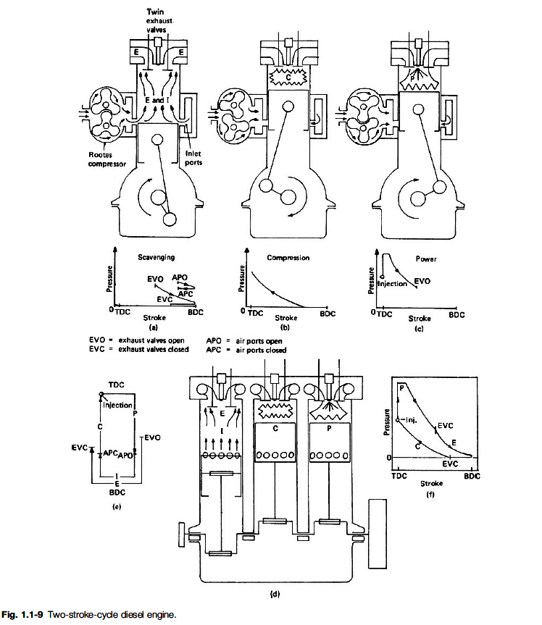
Source: http://www.first-hand.info/TwoStrokeCycleDieselEngine.html

Slide 45
TWO STROKE PETROL ENGINE
HISTORY
The first commercial two-stroke engine involving in-cylinder compression is attributed to Scottish engineer Dugald Clerk, who in 1881 patented his design, his engine having a separate charging cylinder. The crankcase-scavenged engine, employing the area below the piston as a charging pump, is generally credited to Englishman Joseph Day.
Notes:
Source: http://innovatize.blogspot.com/2012/01/two-stroke-petrol-engine.html

Slide 46
The two-stroke engine was very popular throughout the 20th century in motorcycles and small-engined devices, such as chainsaws and outboard motors, and was also used in some cars, a few tractors and many ships.
Part of their appeal was their simple design (and resulting low cost) and often high power-to-weight ratio. Because of the lower cost to rebuild and maintain, the two stroke engine was incredibly popular in the dirt bike and motocross industry for many years, until recently when the EPA required the industry to switch to four-stroke engines because they emit less pollution than two stroke engines
Notes:
Source: http://innovatize.blogspot.com/2012/01/two-stroke-petrol-engine.html

Slide 47
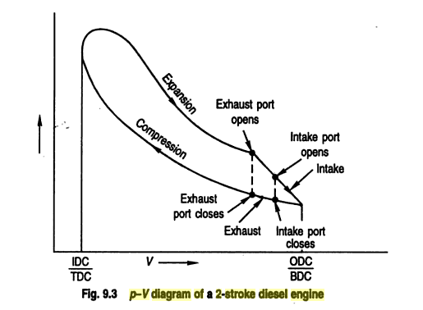
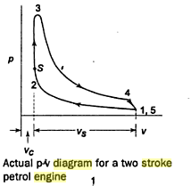
p-v diagram of 2 stroke engine

Slide 48
ATKINSON CYCLE

Slide 49
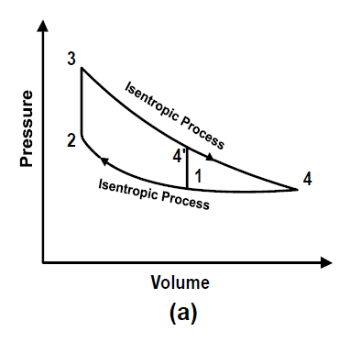
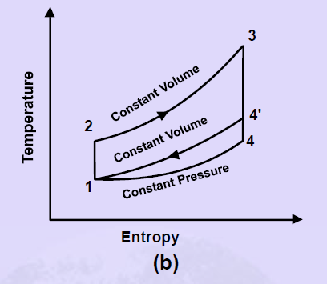
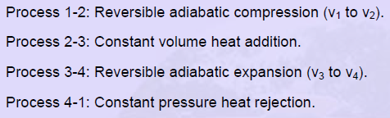
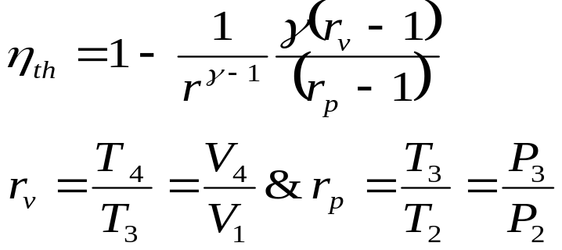
Atkinson cycle on p-v and T-s diagrams

Slide 50
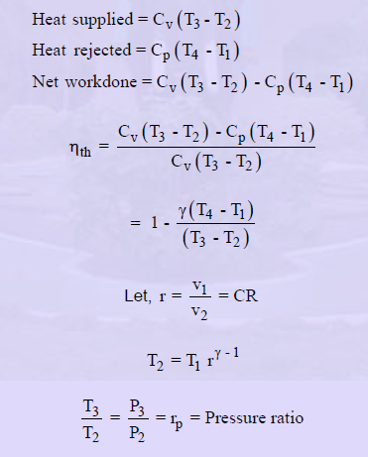
Thermal efficiency of Atkinson cycle
The Atkinson cycle is a variation on the Otto cycle which effectively increased the engine's expansion ratio compared with the compression ratio by using a complex crankshaft linkage. This enables the exhaust stroke to be longer than the induction stroke and hence the swept volumes are different. The greater expansion allows more energy to be extracted from the fuel charge and allows the engine to run cooler. It provides better efficiency at the expense of power density.
Notes:
Source: http://www.mpoweruk.com/heat_engines.htm

Slide 51
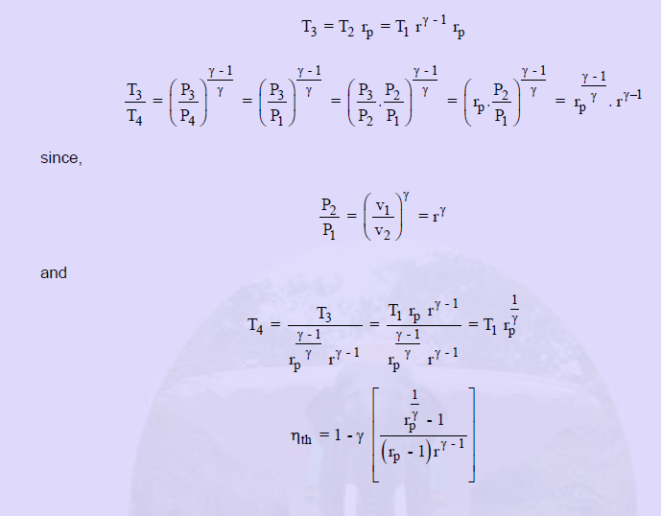
http://www.nptel.iitm.ac.in/courses/IIT-MADRAS/Applied_Thermodynamics/Module_4/9_Atkinson_cycle.pdf

Slide 52
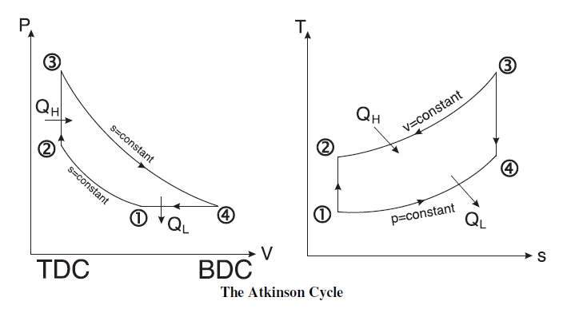
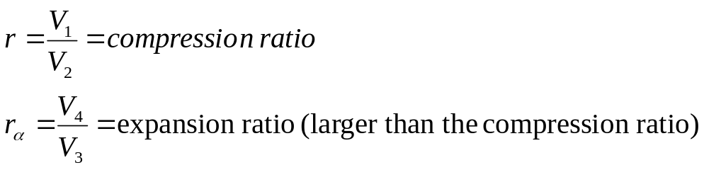
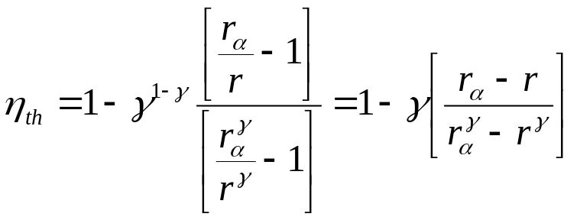
Similar to Otto cycle but with constant pressure heat rejection that allows for a higher expansion ratio (more work extraction) compared to the compression ratio and in turn a higher cycle efficiency.

Slide 53
ATKINSON CYCLE
Advantages
Reduces pumping losses in the engine by using a more efficient combustion cycle
Reduces the amount of fuel-air to be compressed, resulting in greater fuel efficiency
Allows the expansion stroke to be longer than the compression stroke, improving thermal efficiency
Disadvantages
Requires a more complex linkage system
Some engine power is lost due to backflow of fuel-air mixture
Atkinson cycle is used in hybrid vehicles

Slide 54
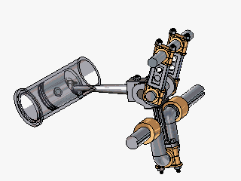
Atkinson-Cycle Engines
Operates on a four-stroke cycle
Intake, compression, combustion, and exhaust strokes occur in a one revolution of crankshaft
Combustion stroke is longer than compression stroke allowing more expansion of combustion gases
Greater efficiency when compared to Otto engines
The Atkinson Cycle Engine

Slide 55
Atkinson-Cycle Engines Continued
Biggest disadvantage is reduction in power density (power/unit volume) arising from the reduction in air intake.
Atkinson cycle engine can be supplemented with electric motor to provide more power if needed.
Electric motors can be used in combination or independent of Atkinson cycle engines to provide the desired power output most efficiently.

Slide 56
STIRLING CYCLE

Slide 57
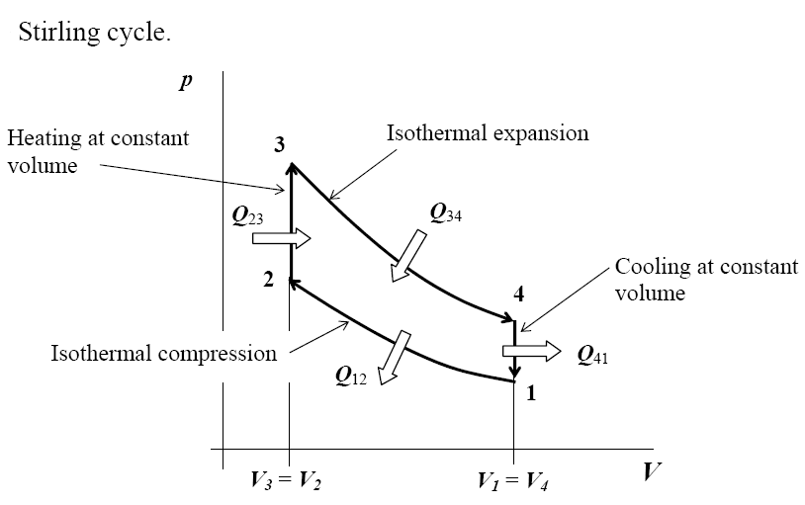
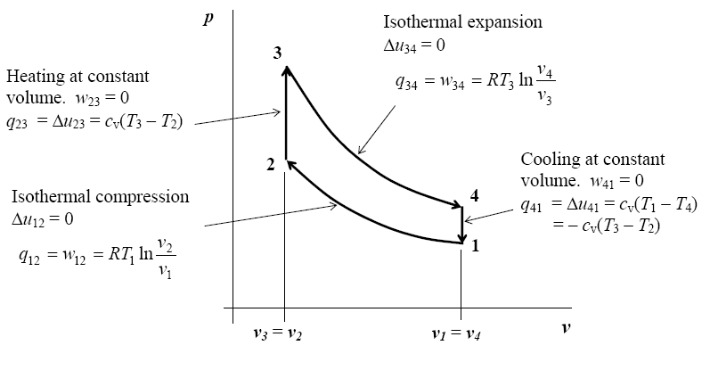
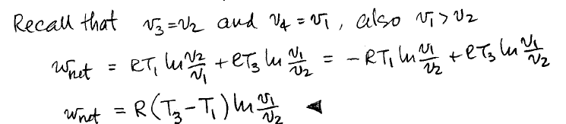
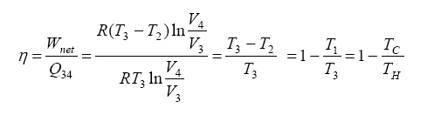
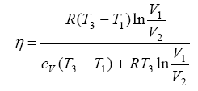
The Stirling Cycle
Process breakdown
For stirling engine
without regeneration
For stirling engine with regeneration

Slide 58
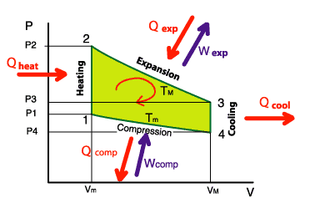
Stirling cycle
Source: http://www.robertstirlingengine.com/theory.php#thermo

Slide 59
Stirling cycle
According to the good old principle: "nothing is lost, nothing is created, everything is transformed" we can approach the energy exchanges during a cycle of Stirling: any loss of calorific energy during a cycle is equal to the recovered mechanical energy during this same cycle.
On the diagram opposite, we see that we provide in calorific energy: Qexp + Qheat
However, we recover: Qcool + Qcomp
About the mechanical energy, we recover Wexp but we provide Wcomp
The overall balance becomes, by stipulating that the heat energy lost was fully transformed into mechanical energy:
Qexp + Qheat - Qcool - Qcomp = Wexp - Wcomp
This leads us to speak about mechanical efficiency: it is the ratio of recovered mechanical energy (the engine goal, in fact) to the heat energy that we must provide:
Efficiency = ( Wexp - Wcomp ) / (Qexp + Qheat )
NB : as we can see it in the page “the regenerator”, it is not necessary to provide Qheat if a regenerator is installed. Indeed, at this time there, we recover Qcool
If we refer to the page “the principles”, we are able to show that the efficiency may be expressed according to the temperatures (expressed in Kelvin) of the heat source and of the cold source, according to the following formula:
Efficiency = 1 - T_{m} / T_{M}

Slide 60
STIRLING CYCLE
Advantages:
Potentially high thermal efficiency. Fairly insensitive to fuel or fuel quality. No lubricants needed; the working fluid can support bearing loads.
Disadvantages:
High cost, which may decrease as less expensive materials are used and more units are produced. Low power density and low power-to-weight ratio. Working fluid leakage and sealing.

Slide 61
Numerical example
Consider an ideal Stirling-cycle engine in which the state at the beginning of the isothermal compression process is 100 kPa, 25°C, the compression ratio is 6, and the maximum temperature in the cycle is 1100°C. Calculate the maximum cycle pressure and the thermal efficiency of the cycle with and without regenerators.
Ans: 2763 kPa, 0.374, 0.783
Source: http://nptel.iitm.ac.in/courses/101101001/downloads/lec20-problem-solution.pdf

Slide 62
BRAYTON CYCLE

Slide 63
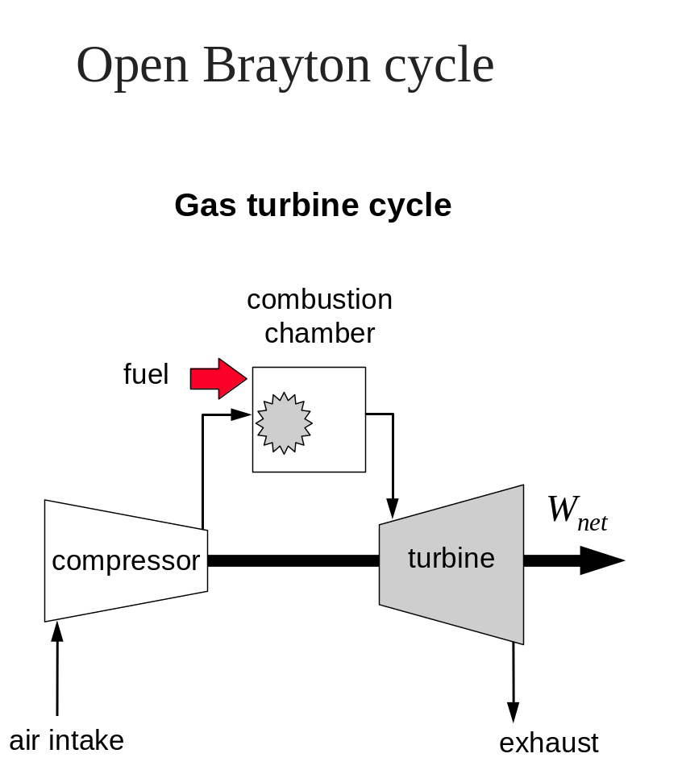
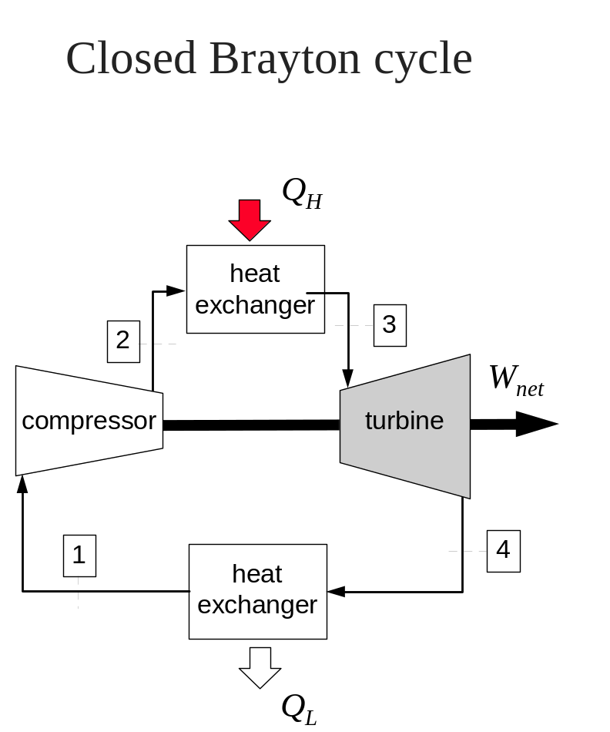
BRAYTON CYCLE

Slide 64
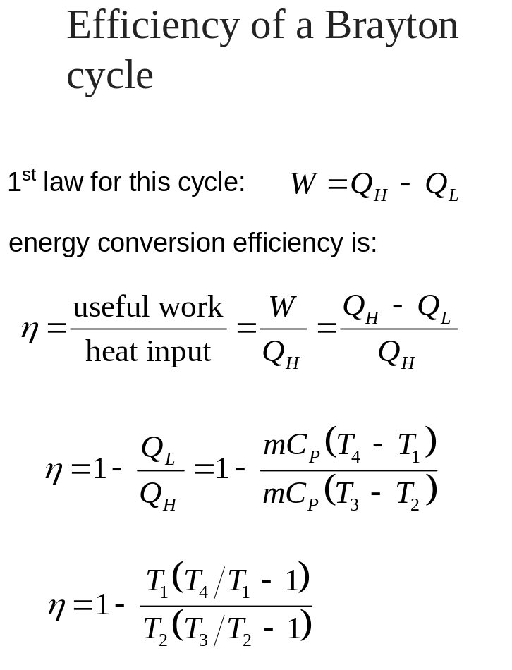
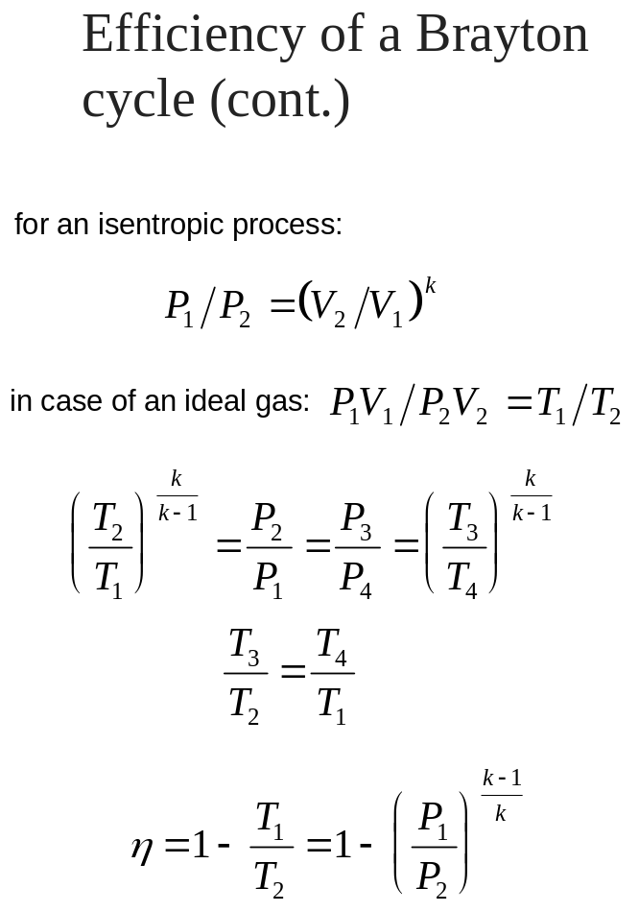
EFFICIENCY OF A BRAYTON CYCLE

Slide 65
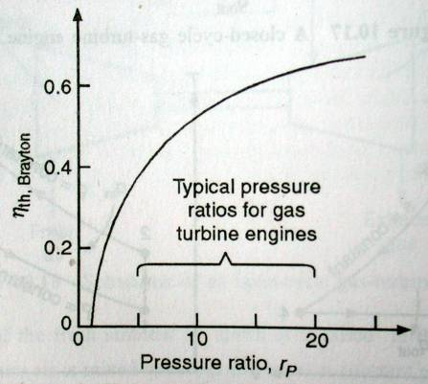
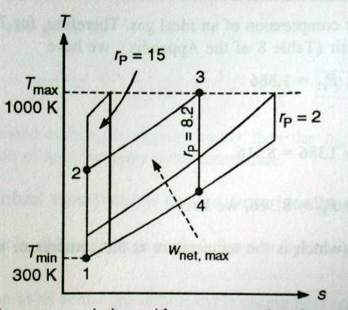
Efficiency vs pressure ratio
Notes:
The maximum temperature in the cycle (T3) is limited by metallurgical conditions because the
turbine blades cannot sustain temperatures above 1300 K. Higher temperatures (up to 1600 K can
be obtained with ceramic turbine blades). The minimum temperature is set by the air temperature
at the inlet to the engine.

Slide 66

Max net work
Notes:
The maximum temperature in the cycle (T3) is limited by metallurgical conditions because the
turbine blades cannot sustain temperatures above 1300 K. Higher temperatures (up to 1600 K can
be obtained with ceramic turbine blades). The minimum temperature is set by the air temperature
at the inlet to the engine.

Slide 67


EFFICIENCY (cont.)

Slide 68
DEVIATION OF ACTUAL GAS-TURBINE CYCLE FROM IDEALIZED CYCLE
The actual gas turbine cycle differs from the ideal Brayton cycle because of the following reasons:
Some pressure drop in an actual gas turbine cycle during heat addition and heat rejection processes is unavoidable.
Owing to irreversibility, such as friction and non-quasi-equlibrium operation conditions of actual devices, the actual work input ot the compressor will be more, and the actual work output from the turbine will be less.
Notes:
Sp heat of real gases varies with the variation of temperature.

Slide 69



Slide 70
BRAYTON CYCLE
Advantages:
These continuous flow machines offer a high power density, and a respectable efficiency at full load on the order of 30% for the open cycle, and even higher for the closed. Brayton cycles are fairly insensitive to fuel quality. The sizes considered for this study also have a distinct advantage over other methods in that the rotating components can be supported by air bearings in any orientation. Thus, no auxiliary lubricating fluid or oil is needed.
Disadvantage:
The primary disadvantage is cost. Although expensive alloys are now used, the cost will decrease as less expensive materials are used and more units are produced.

Slide 71
References:
itivzm.com/ACADEMIC/4-2%20Stroke%20Diesel.ppt‎

